Slide 1
F2BP
Website for first-birthday party
202135740 김예림
Desgined. 2018 YPTLAB

Slide 2

Project title
Motivation & Goal
F2BP
:for first-birthday party
Motivation:
Goal:
A web page can have first birthday party non-face-to-face.
Zoom or Webex
Non-face-to-face meeting

Slide 3


Related work
Non-face-to-face video calls

Slide 4
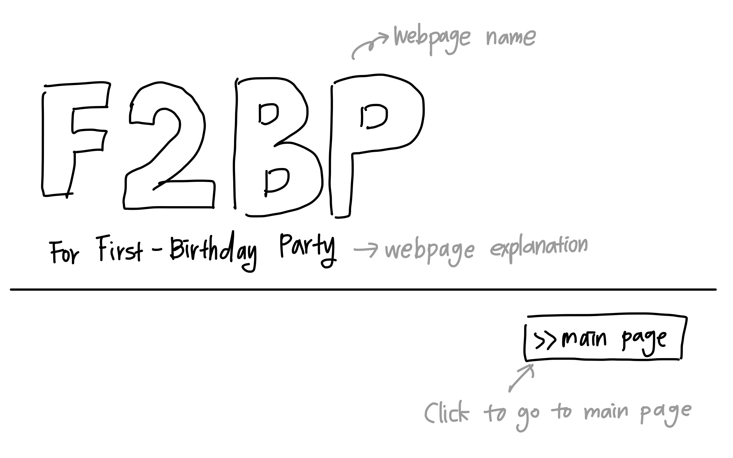
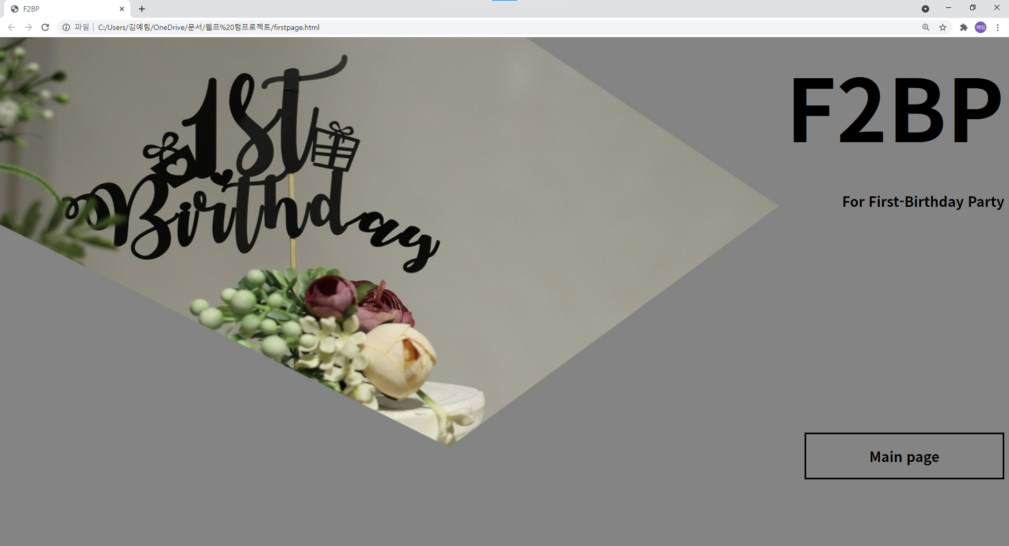
First page

Slide 5
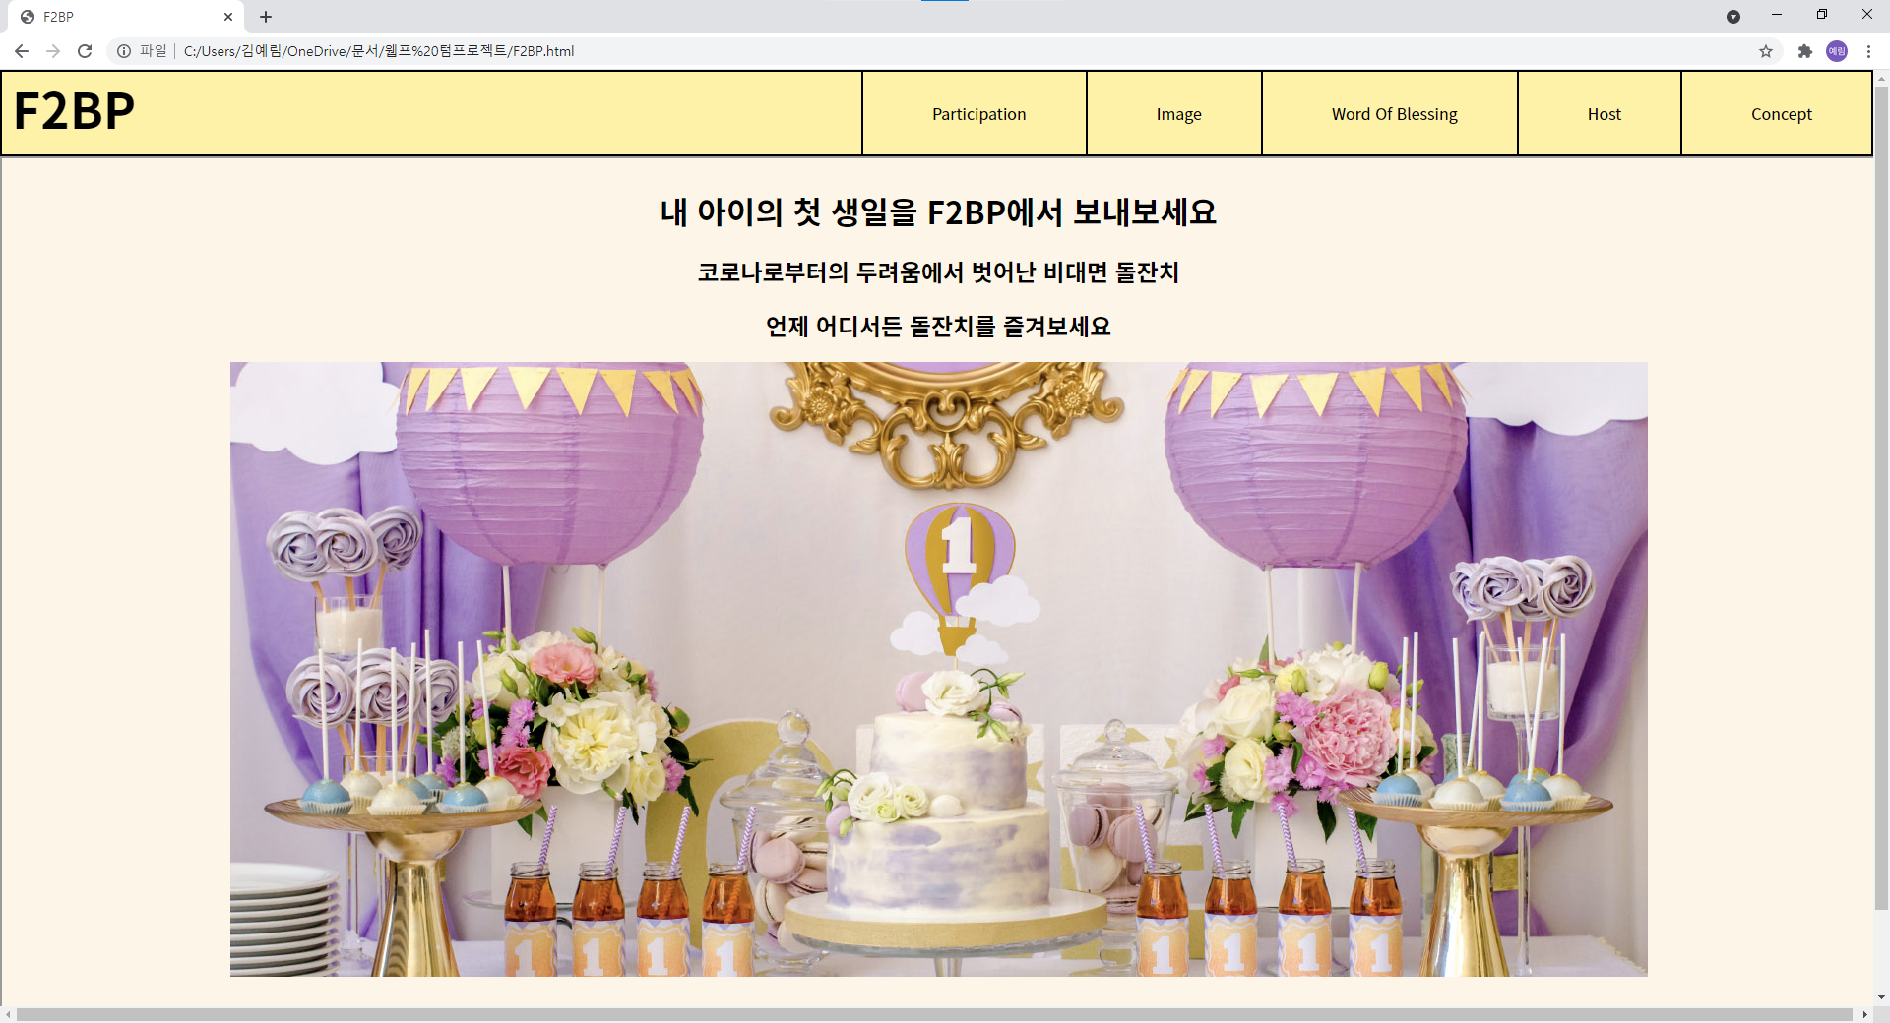
Main Page (Addition)

Slide 6
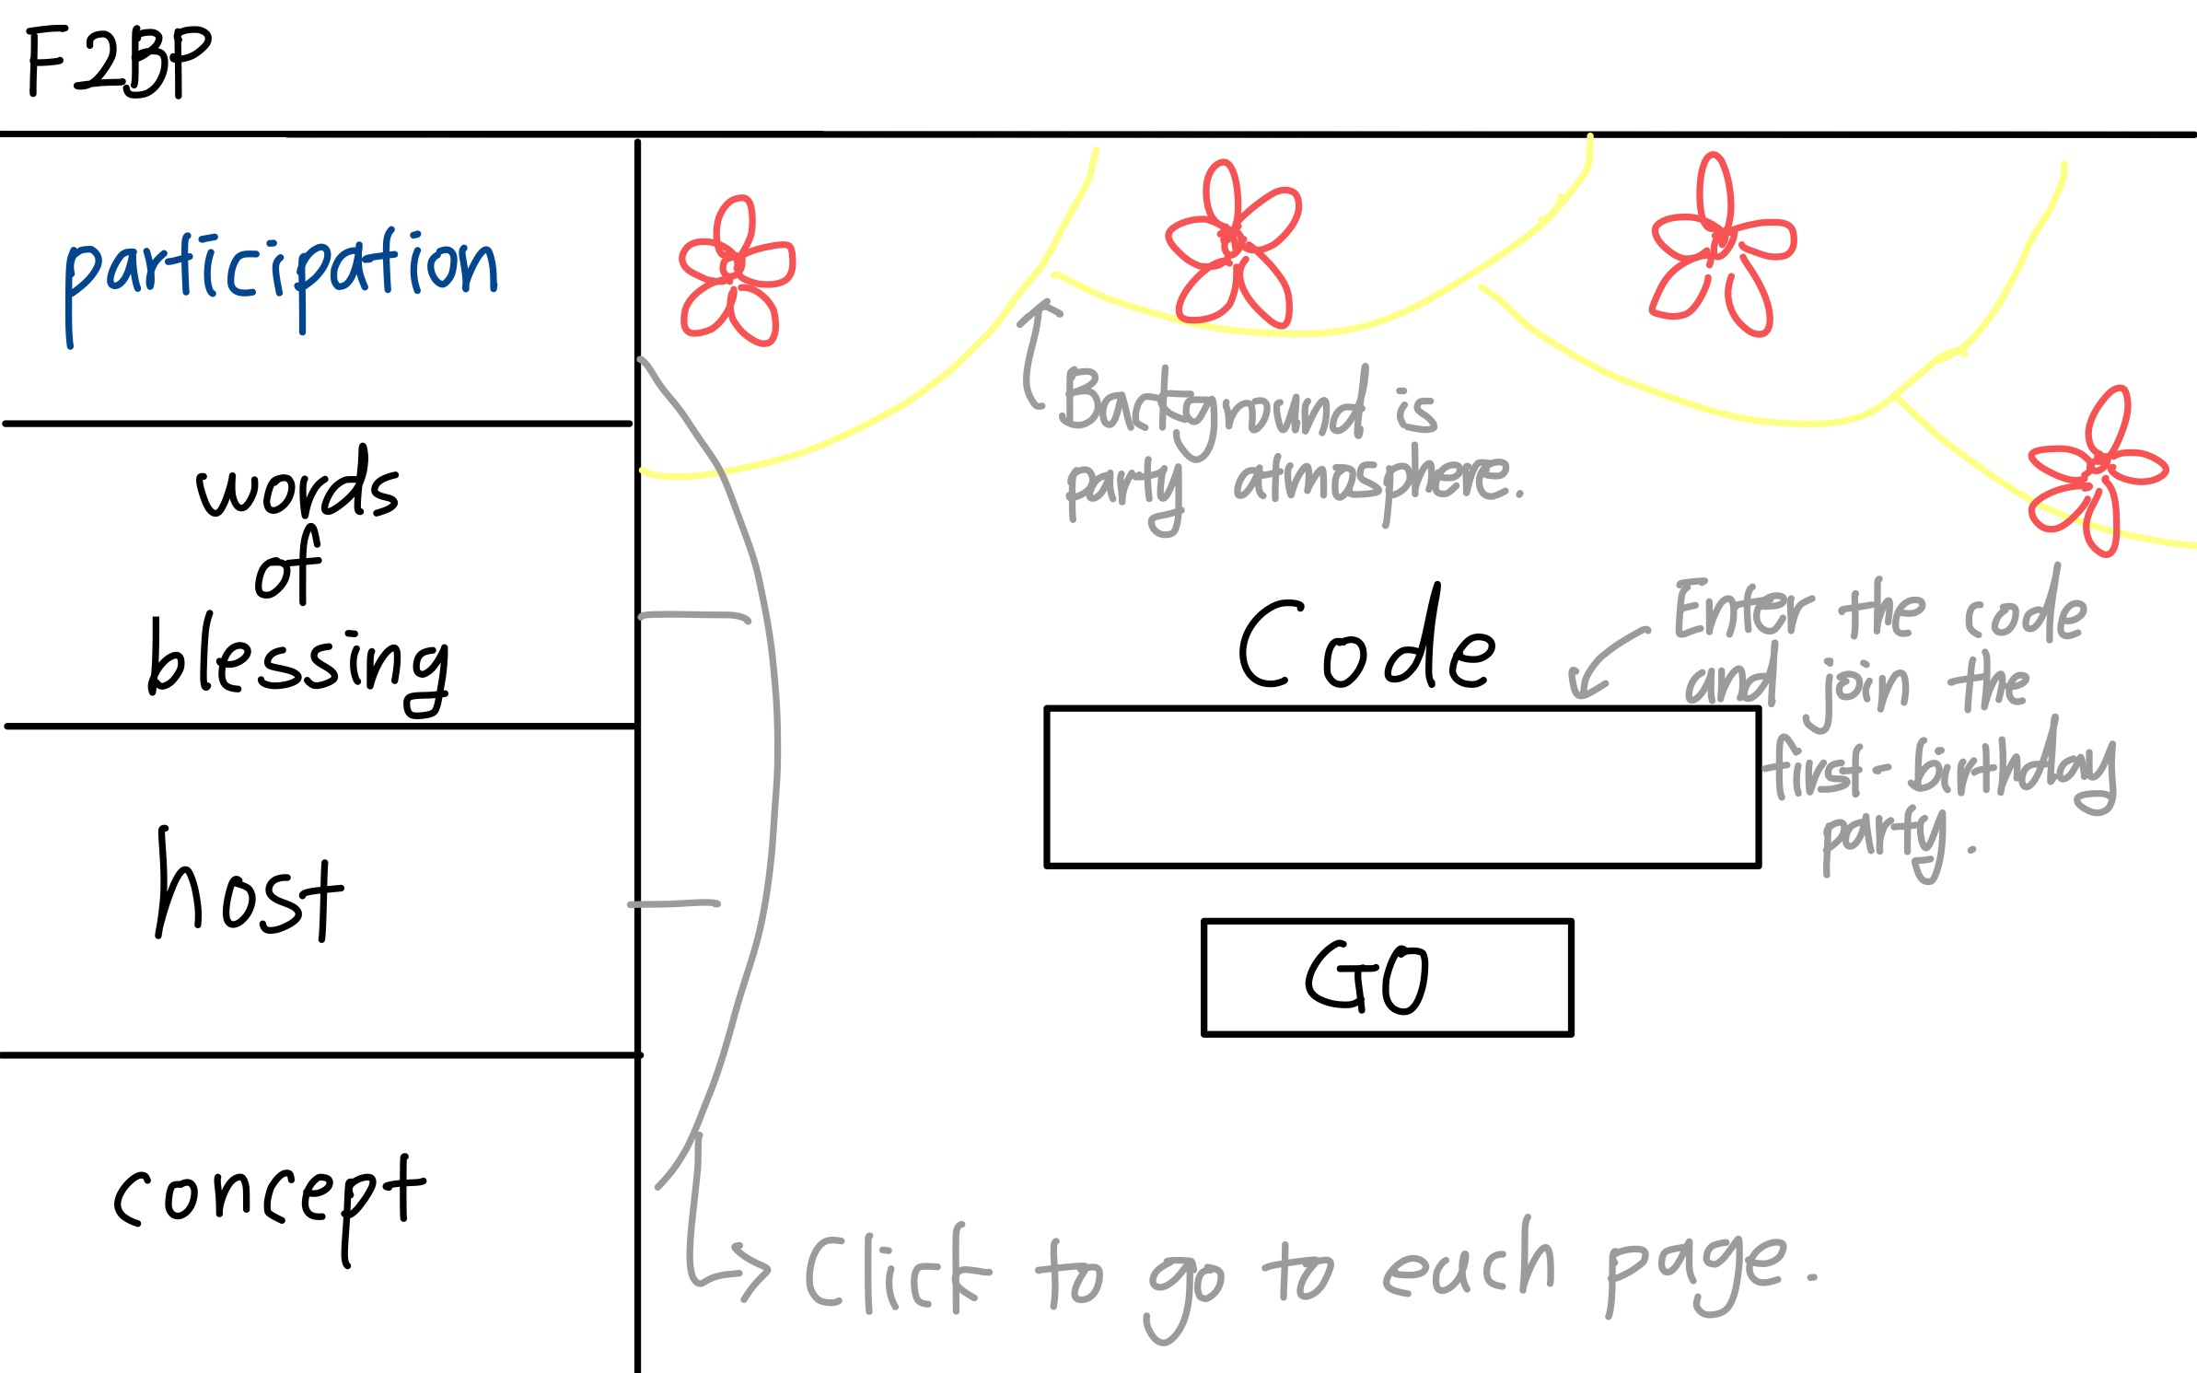
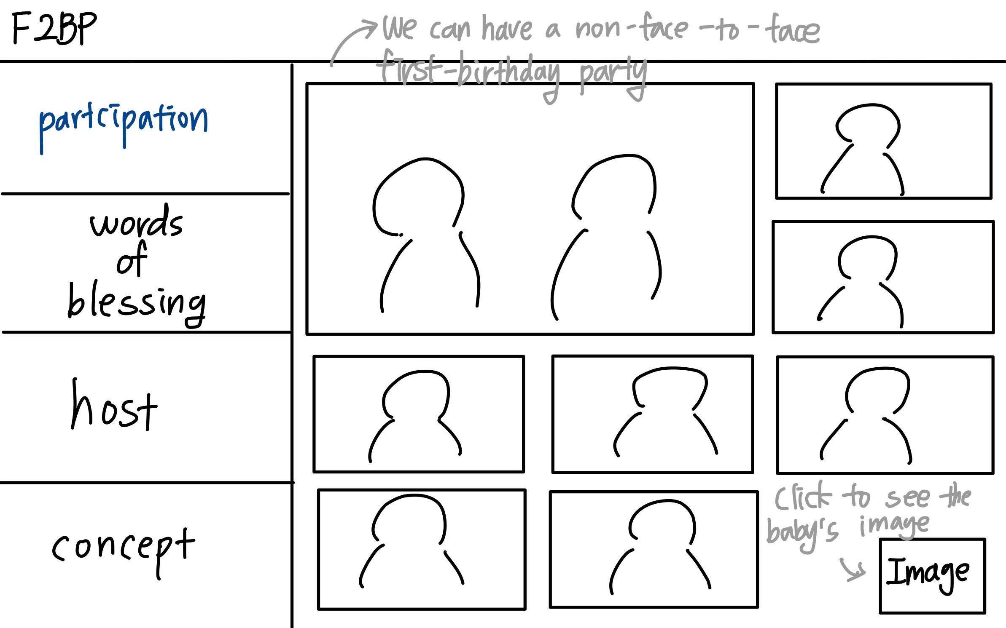
Participation
If you enter the code, you can attend the first-birthday party non-face-to-face.

Slide 7
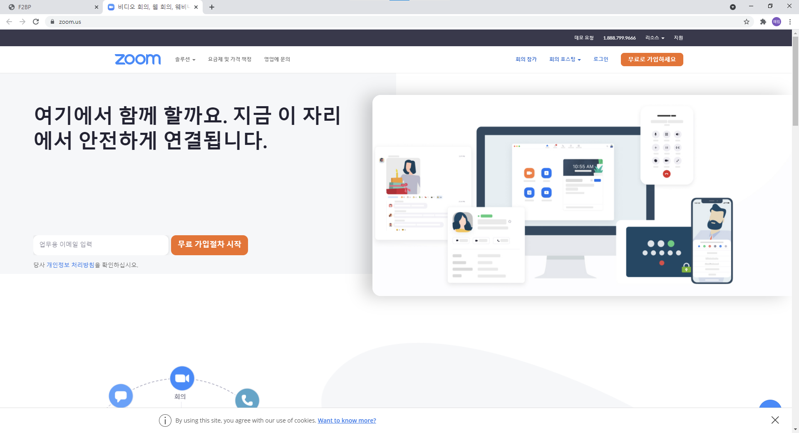
Participation
Concept

Slide 8
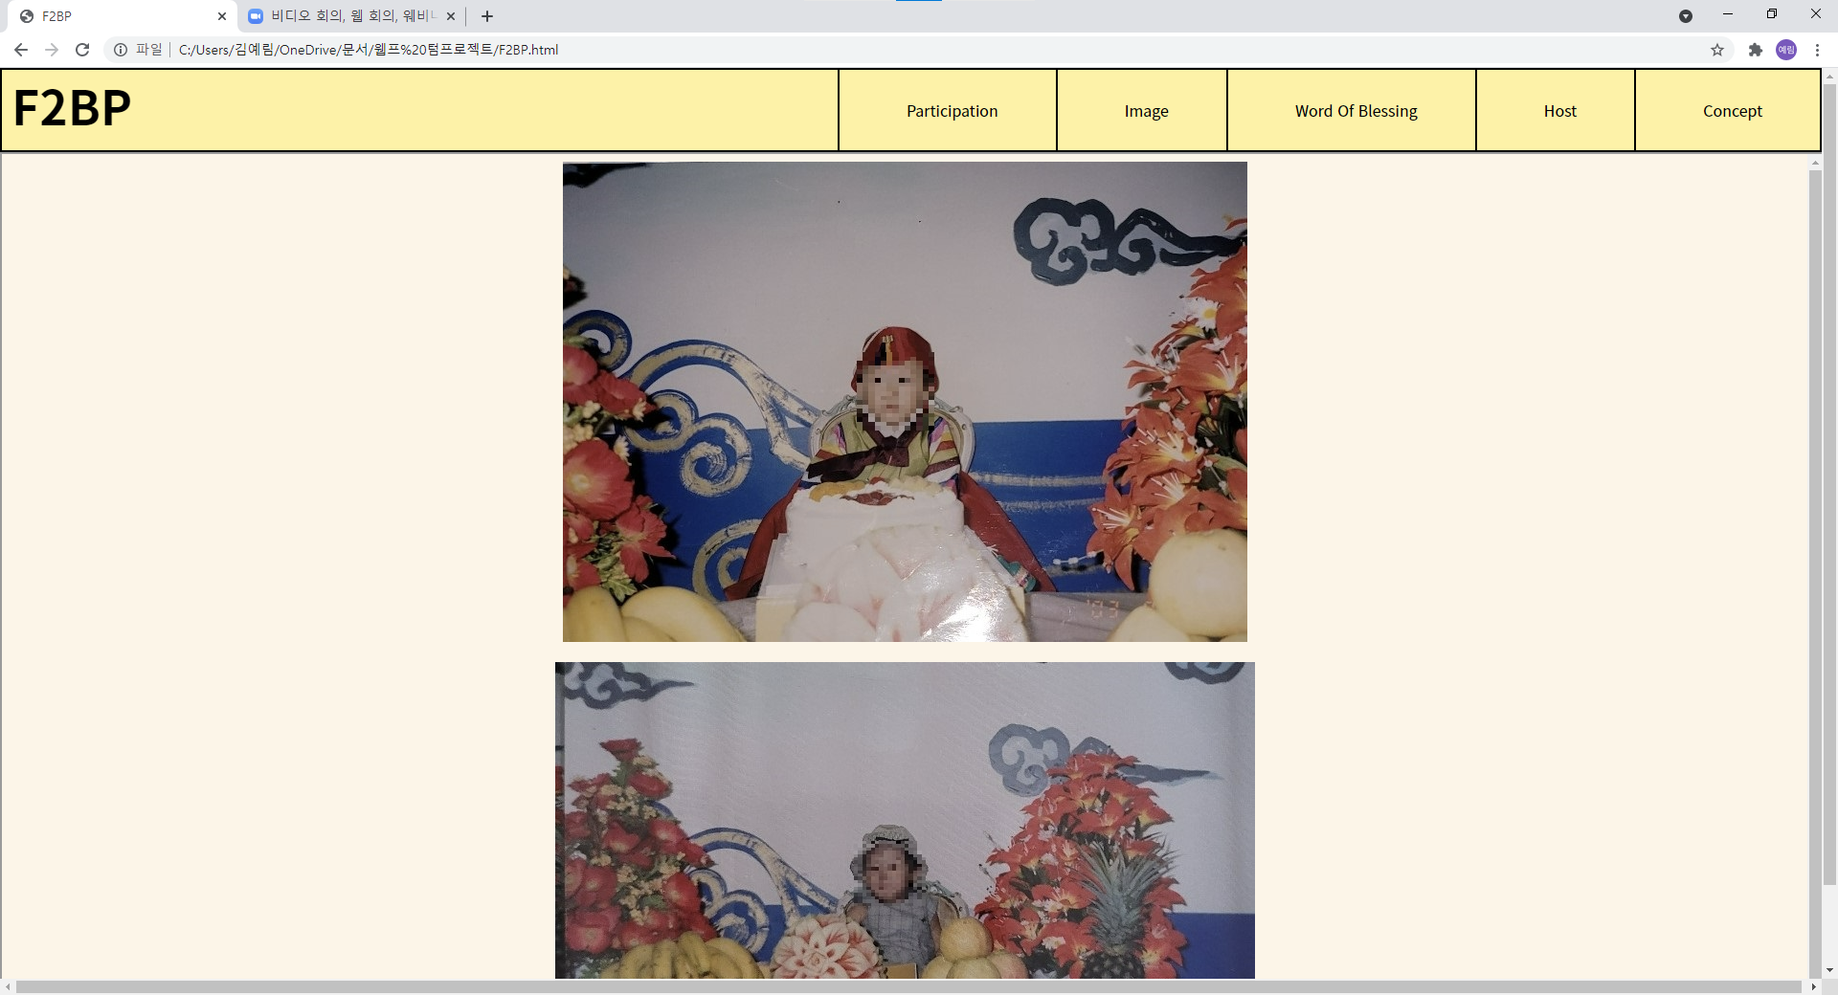
Image (Addition)

Slide 9
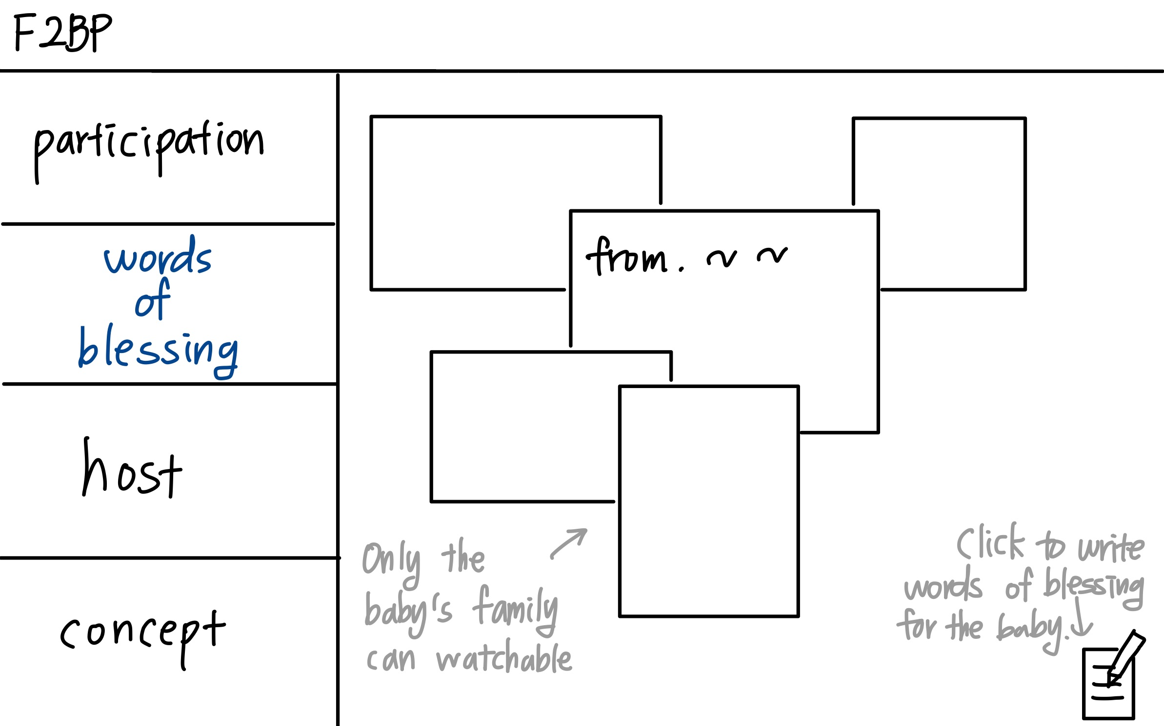
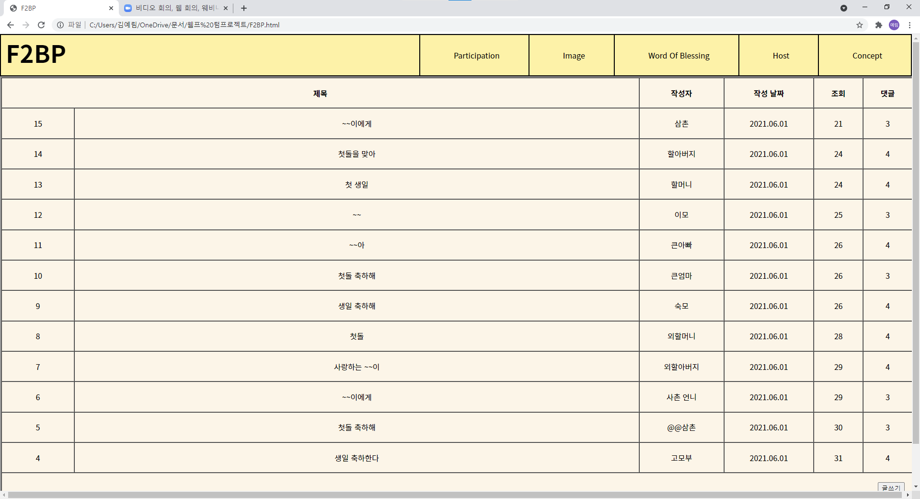
Words of blessing

Slide 10
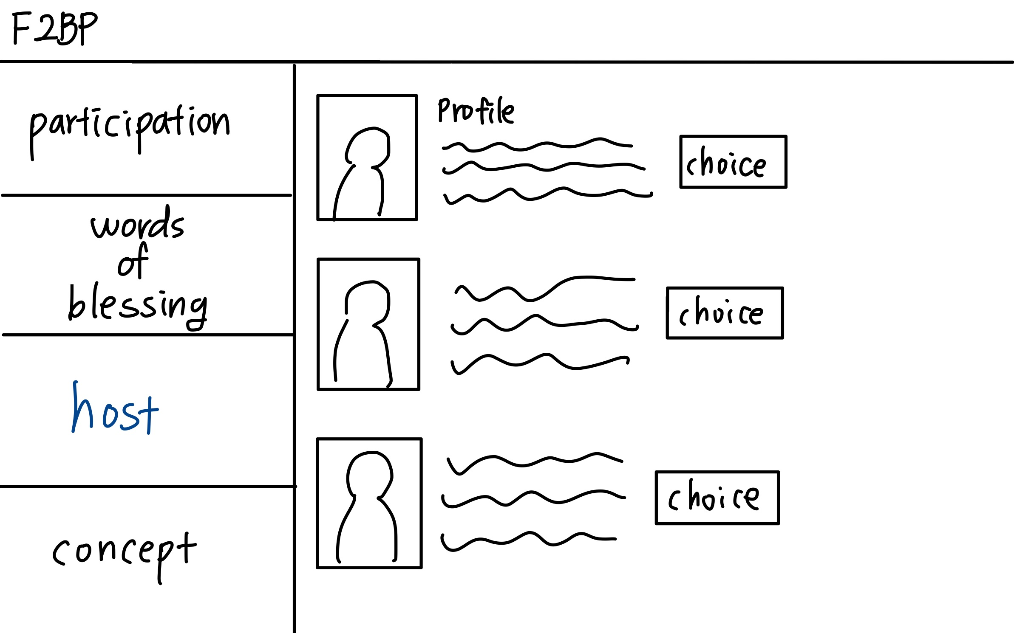
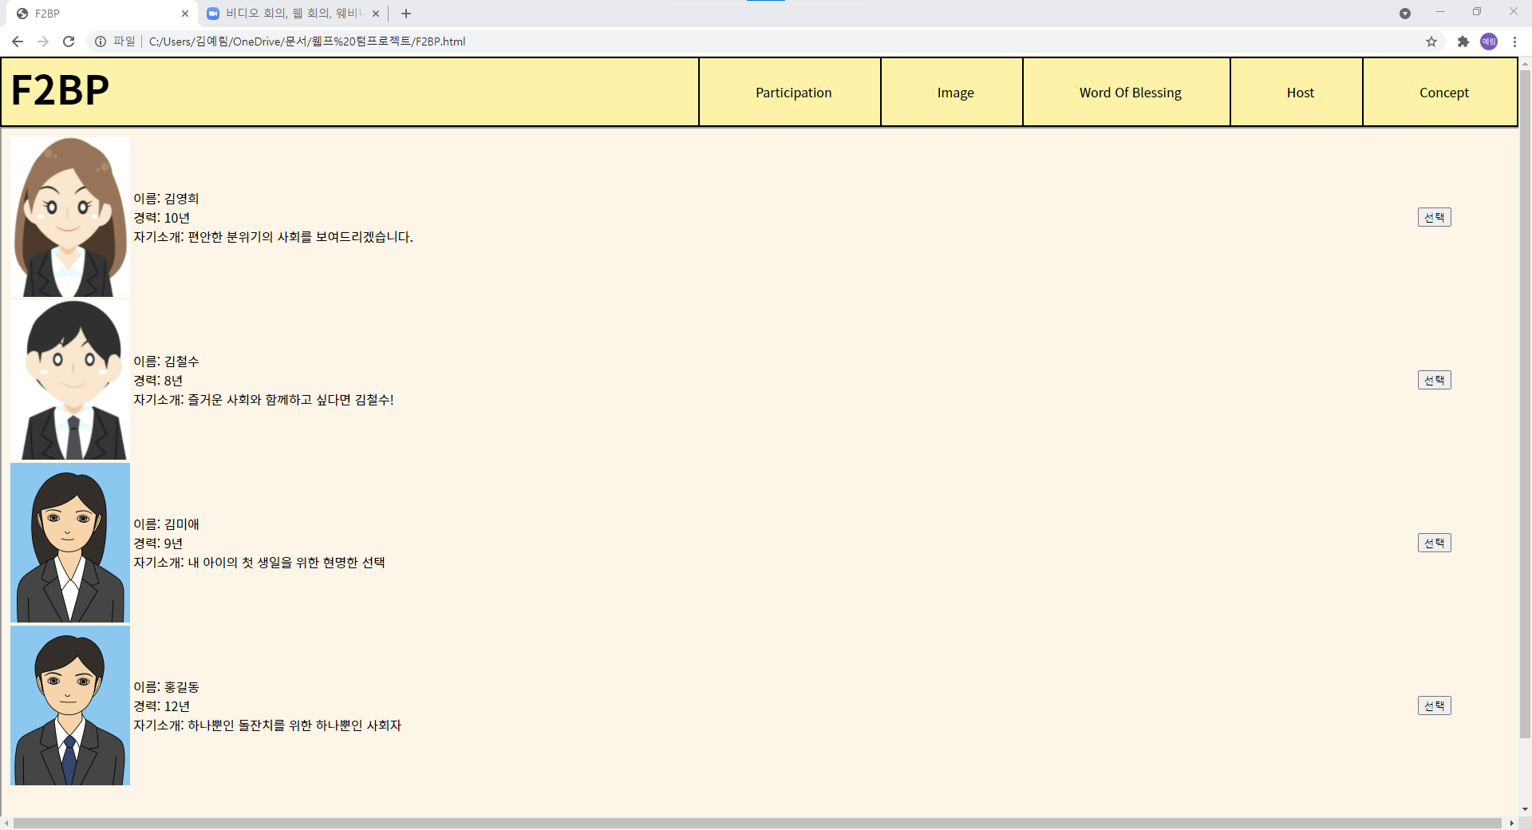
Host

Slide 11
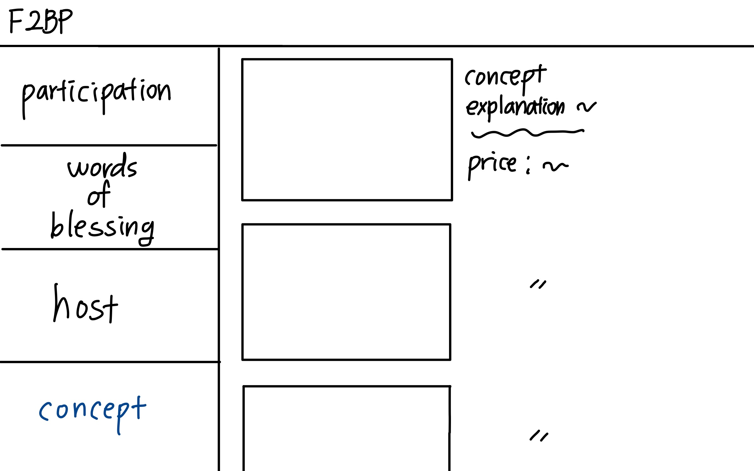
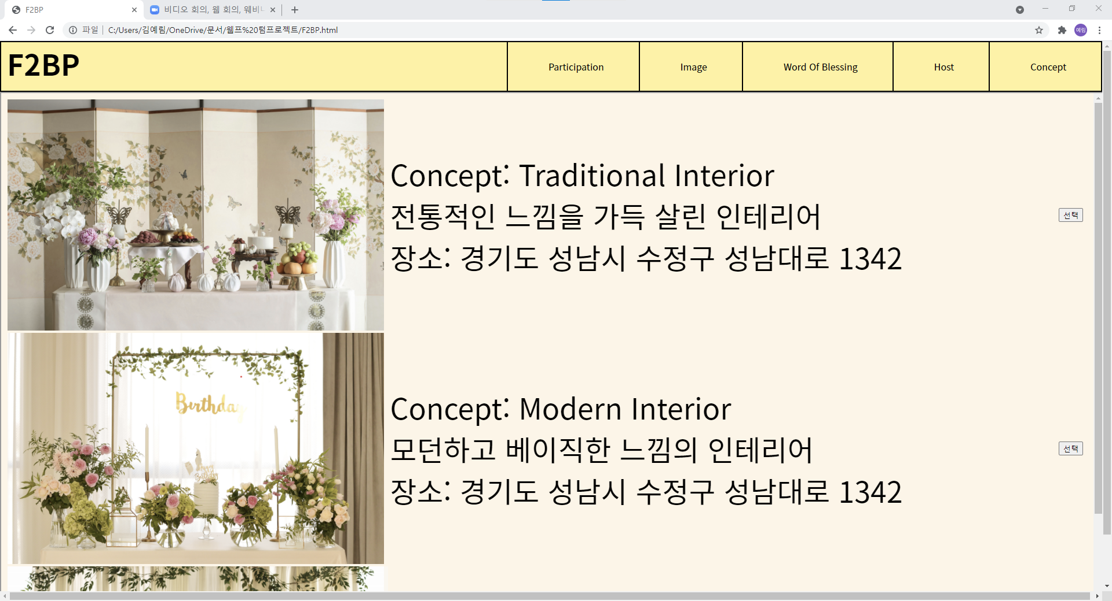
Concept
firstpage

Slide 12
Conclusion & Future work
It has only realized what it was thinking on the surface.
But if I learn more various programming languages, I can make the webpage that I planned.
When I learn what it takes to make a website, I want to make this website again.

Slide 13
Thank you
Desgined. 2018 YPTLAB

